Slide 1
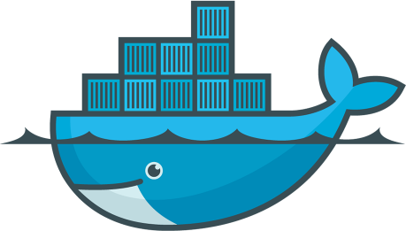
Introduction To Docker
Kanishka Dilshan De Silva

Slide 2
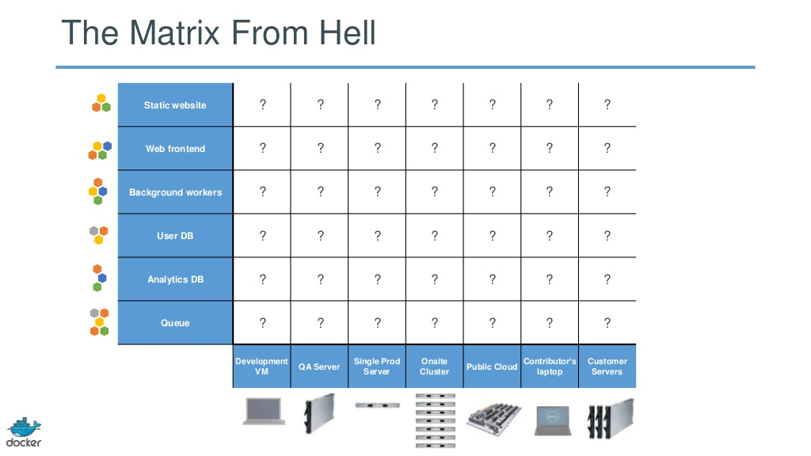
The Challenge

Slide 3
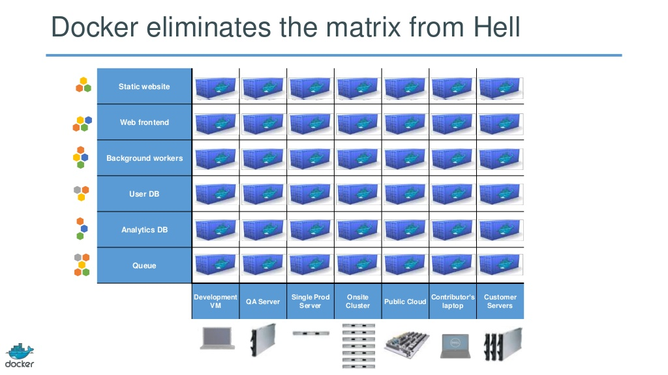
The Solution

Slide 4

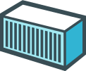

Why Docker?
Build
Ship
Run

Slide 5
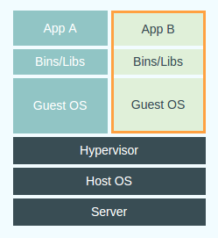
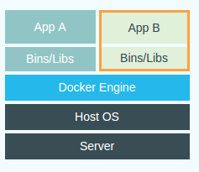
Docker vs Virtual Machines
VM
Docker

Slide 6
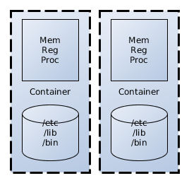
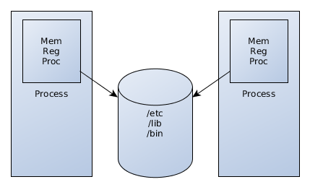
Process vs Container
Linux kernel features
Kernal namespaces
Control groups (cgroups)

Slide 7
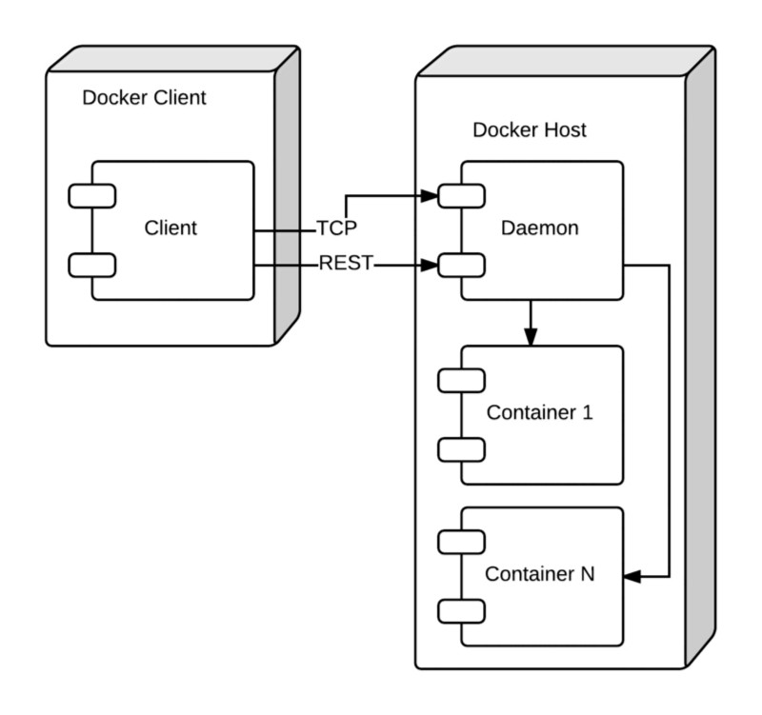
The Docker Architecture

Slide 8
Setting up Docker
https://docs.docker.com/installation/
Ubuntu 14.04
  $ sudo apt-get update
  $ sudo apt-get install docker.io
Windows
  Using Boot2Docker*
Mac Osx
  Using Boot2Docker*
*Boot2Docker (~24Mb lightweight linux distribution)

Slide 9
Docker CLI Commands
search
run
ps
start
stop
restart
rm
rmi
kill
commit
pull

Slide 10
Docker CLI Examples
Creating a simple container from an image
  docker run -i -t ubuntu:14.04 /bin/bash
Listing containers
  docker ps
Stop container
  docker stop <container hash>
Remove container
  docker rm <container hash>

Slide 11
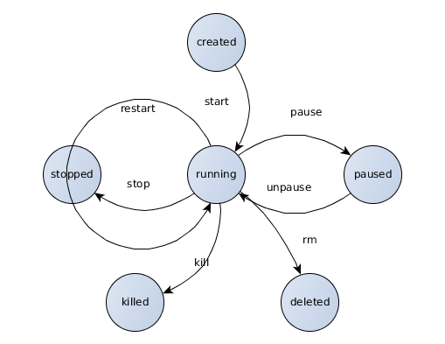
Container Lifecycle

Slide 12
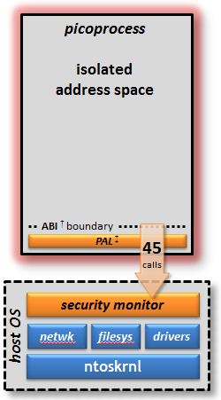
MS Native Alternatives
Drawbridge - Still in research level
  picoprocess = container
http://research.microsoft.com/en-us/projects/drawbridge/

Slide 13






Use Cases
Easy application deployment
Continuous Integration
Continuous Delivery

Slide 14
Q&A

Slide 15
Demo

